Slide 1
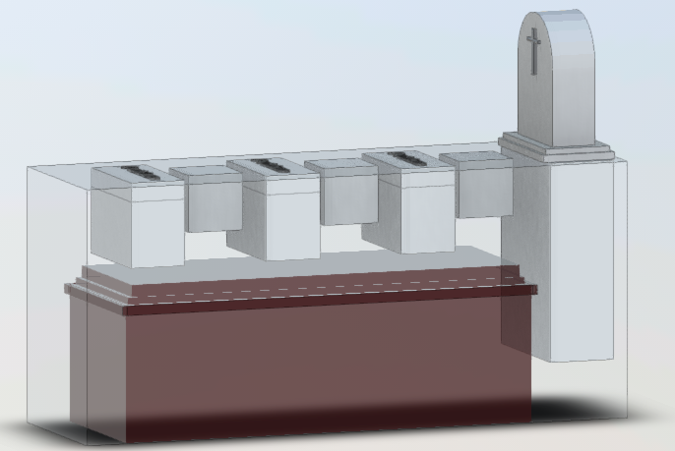
Central Cemetery of Brookfield, Connecticut
PO Box 821 | 490 Federal Road
Brookfield, CT 06804
(203) 775-3278
Eagle Scout
Consulting Project
Application of Pythagorean Theorem
Logan White
Ben Bogues
Situation: Structural Performance Failures
Analysis: Determine Prevalence of Problem
Proposed 1st Action: Develop Method
Anticipated Result: Reproducible Approach
November 28, 2020
What angle?
What length probe to detect if 42”?
What actual depth if not 42”?
Monument Foundation
L x W x D
36 x 14 x 42
1. Actual depth
2. >= 42 Yes/No
42”

Slide 2
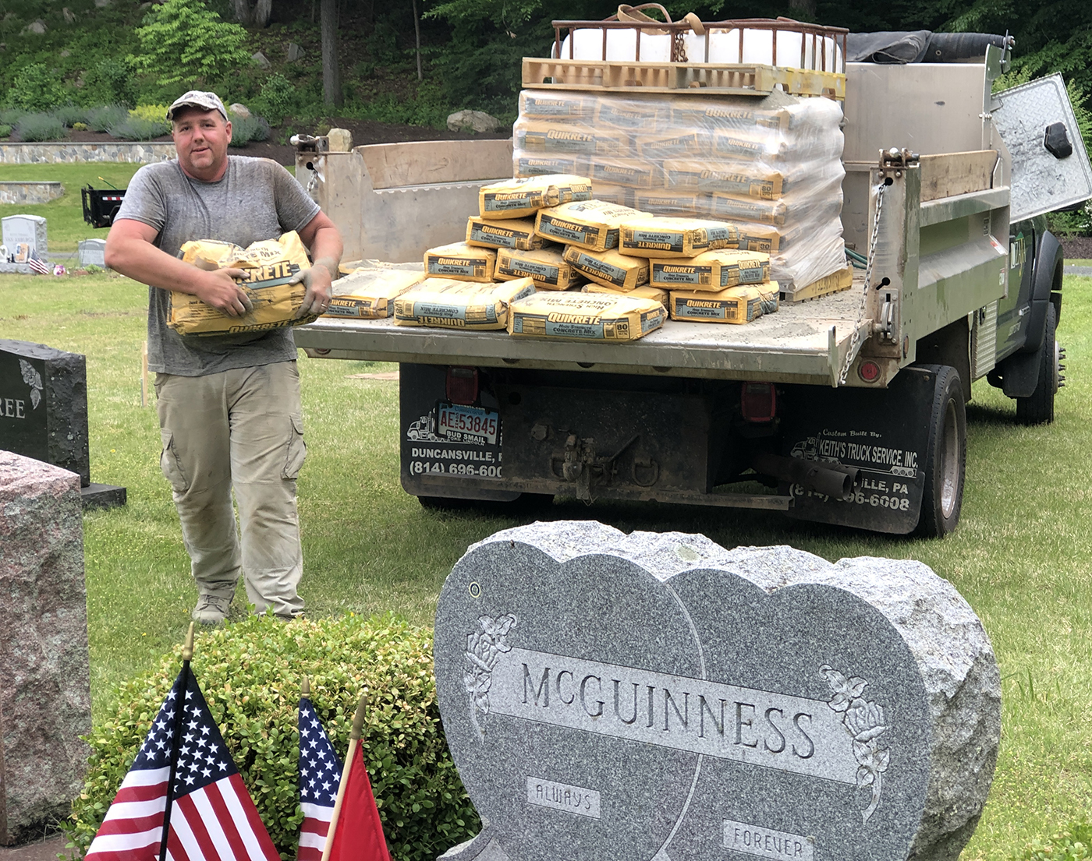
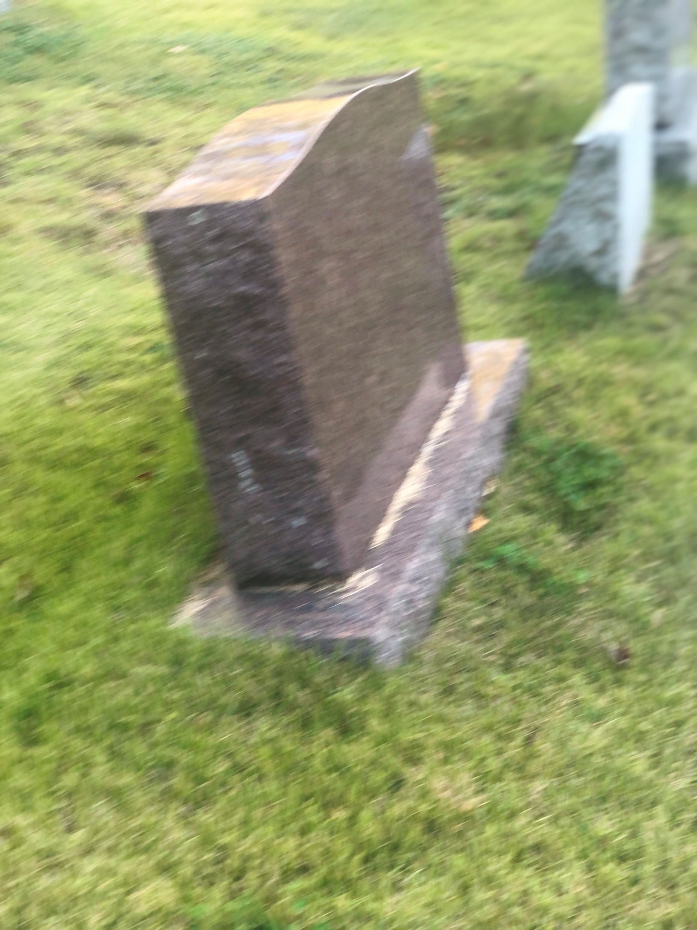
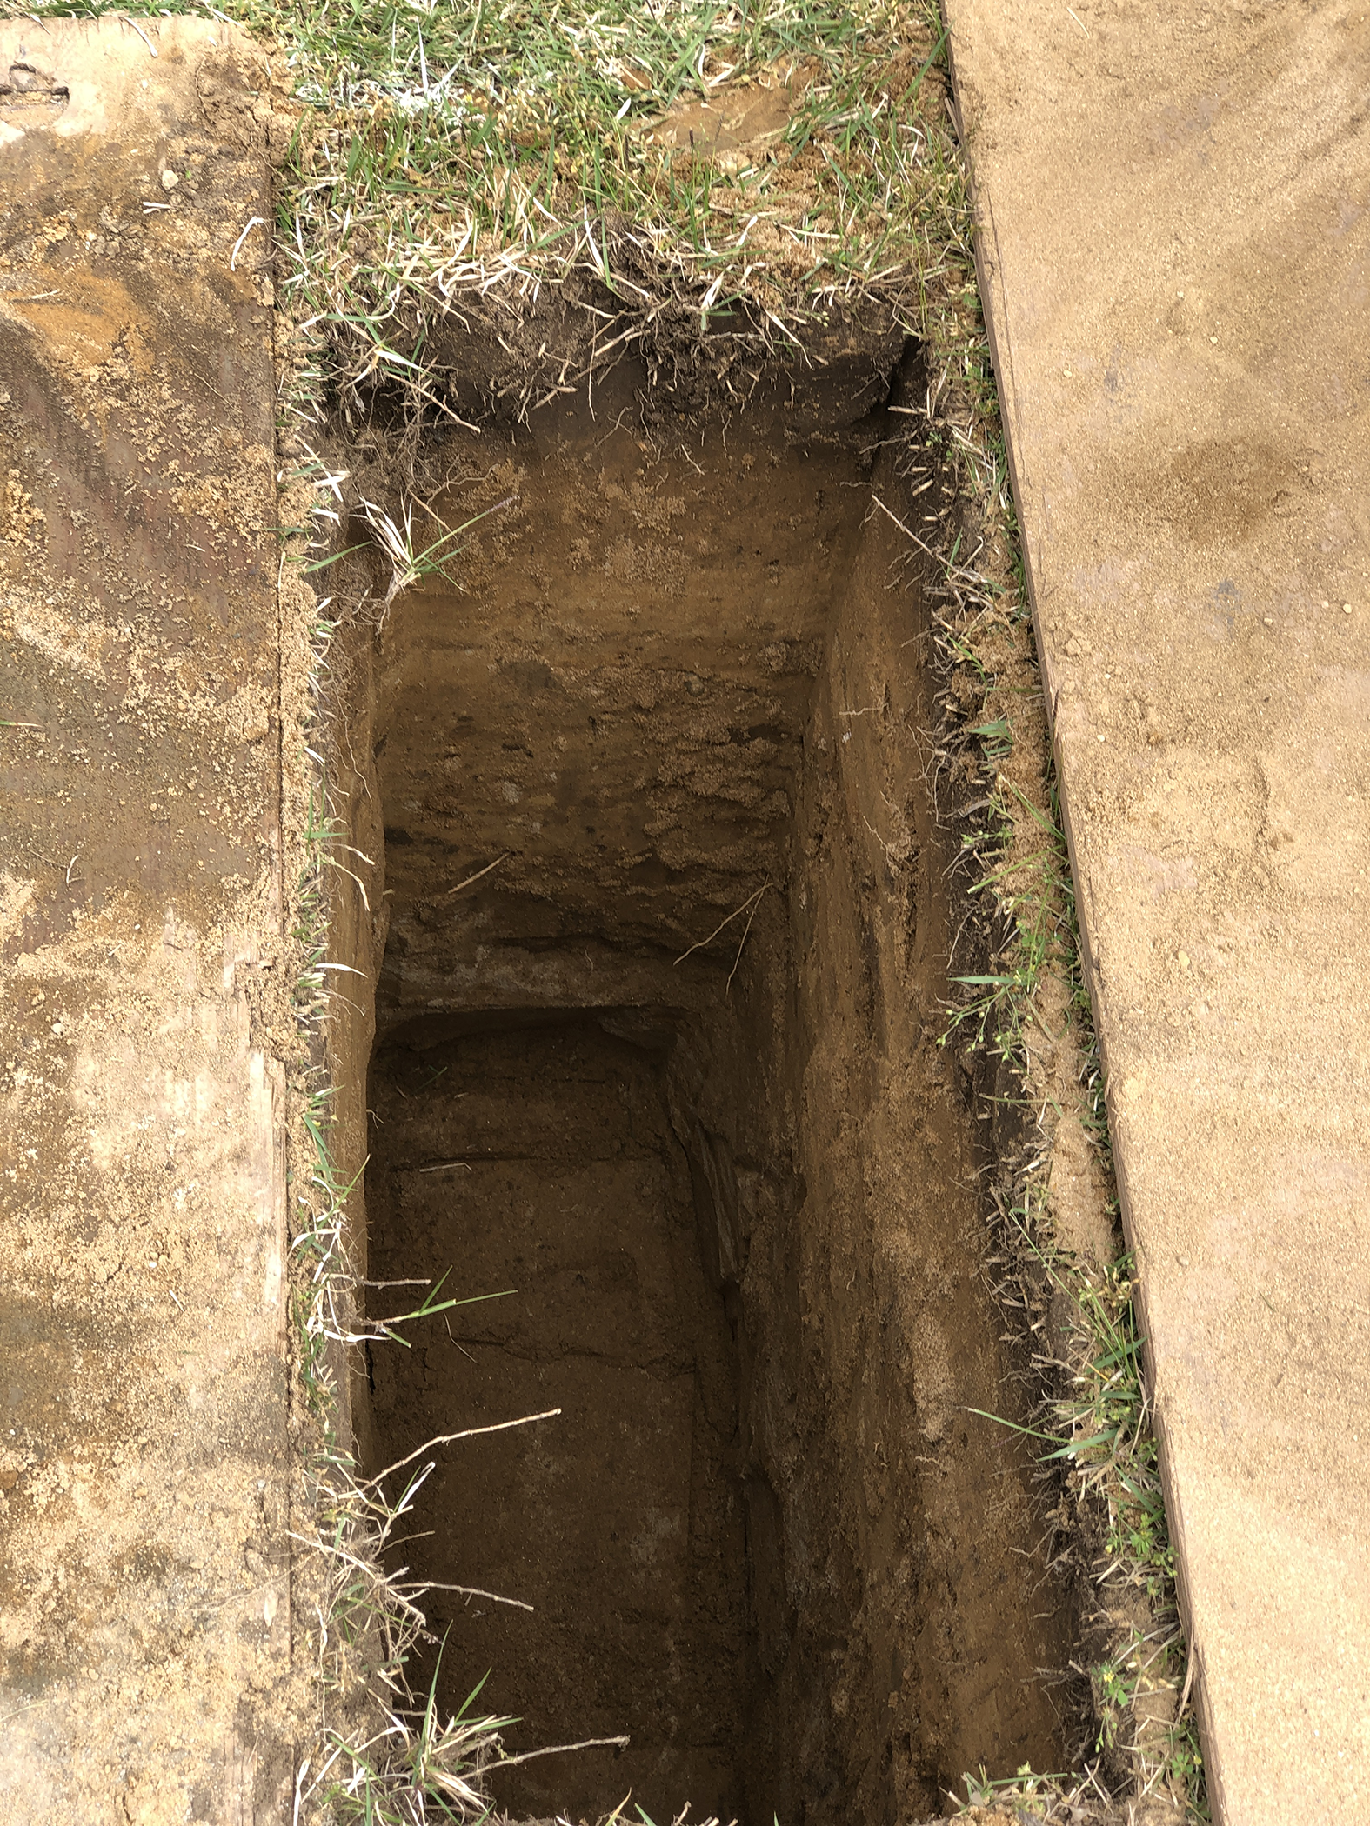
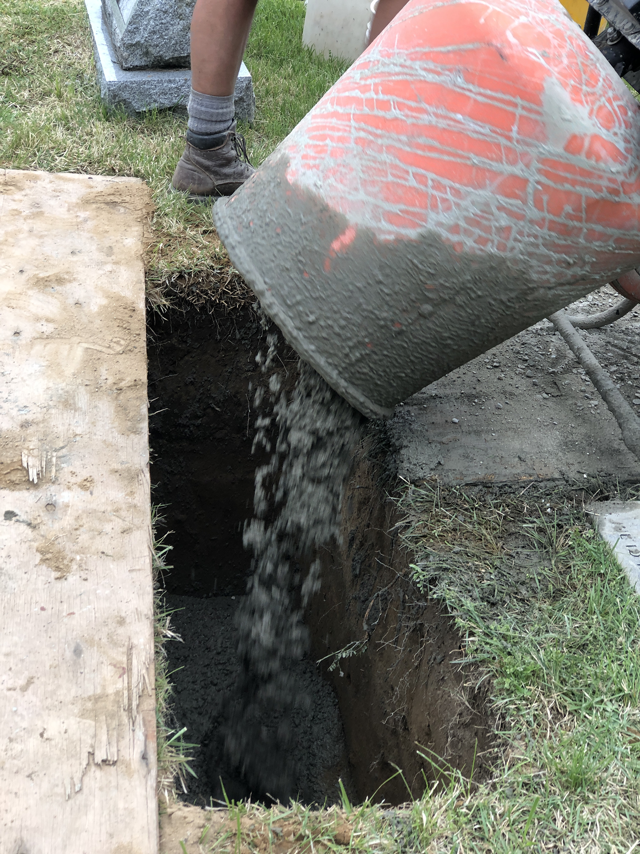
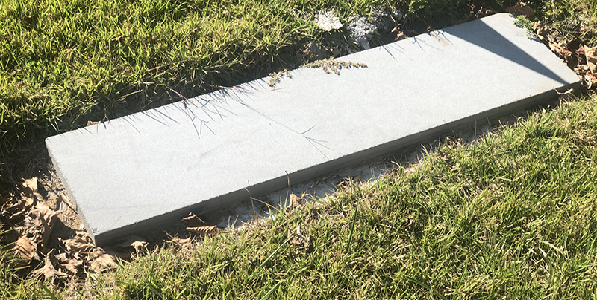
Monument Foundation
Example of 42” Standard
36 x 14 x 42 in
The Problem:
Structural Performance Failure
Non-Compliant to 42” Standard

